Slide 1





Entity Framework Performance
N+1 Query Problem, ToList(), SELECT *, Deleting/Updating
Database
Applications
SoftUni Team
Technical Trainers
Software University
http://softuni.bg
Entity Framework

Slide 2



Table of Contents
SQL Profilers
The N+1 Query Problem
Incorrect Use of ToList()
Incorrect use of SELECT *
Deleting Objects Faster with Native SQL

Slide 3
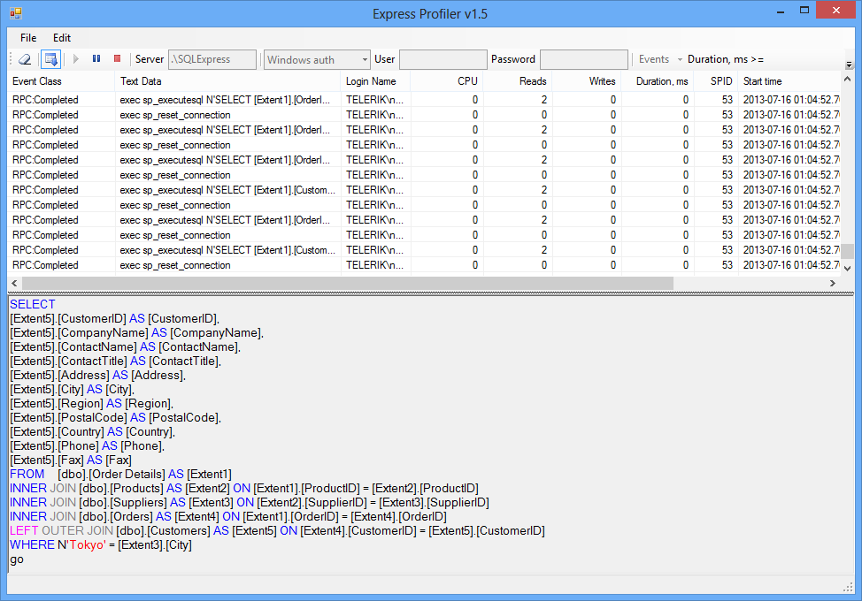
SQL Profilers
How to Trace All Executed SQL Commands?

Slide 4
What is SQL Profiler?
SQL Profilers intercept the SQL executed at the DB server
Diagnose performance problems in database applications
May display the hidden Entity Framework SQL queries
SQL Server has "SQL Server Profiler" tool
Part of MS SQL Server Enterprise / Developer edition (paid tool)
A free SQL Profiler exists for SQL Server:
Express Profiler: http://expressprofiler.codeplex.com
Easy-to-use, open-source, lightweight, powerful, … and works!

Slide 5
Express Profiler
Live Demo

Slide 6

The N+1 Query Problem
What is the N+1 Query Problem and How to Avoid It?

Slide 7
The N+1 Query Problem
What is the N+1 Query Problem?
A database holds tables Employees, Addresses, Towns and Departments
We want to print each employee along with his department and town
foreach (var emp in context.Employees)
{
Console.WriteLine("{0}; {1}; {2}",
emp.LastName, emp.Department.Name,
emp.Address.Town.Name);
}

Slide 8
The N+1 Query Problem (2)
First query: SELECT * FROM Employees
This will execute 3*N + 1 SQL queries:
Imagine we have 300 employees
That's ~ 901 SQL queries (less due to caching) → very slow!
We could get the same data with a single SQL query with JOINs
foreach (var emp in context.Employees)
{
Console.WriteLine("{0}; {1}; {2}",
emp.LastName, emp.Department.Name,
emp.Address.Town.Name);
}
N more queries: SELECT * FROM Departments
2*N more queries:
SELECT * FROM Addresses
SELECT * FROM Towns

Slide 9
Solution to the N+1 Query Problem
EF provides an easy way to avoid the N+1 query problem:
using System.Data.Entity;
…
foreach (var emp in context.Employees
.Include(e => e.Department)
.Include(e => e.Address.Town))
{
Console.WriteLine(" {0}; {1}; {2}",
emp.LastName, emp.Department.Name,
emp.Address.Town.Name));
}
First, include System.Data.Entity
Using Include(…), a single SQL query with JOIN will be executed to load all included entities
No additional SQL queries to access the included relations

Slide 10

Solving the N+1 Query Problem
Live Demo

Slide 11


Incorrect Use of ToList()
ToList()
How ToList() Can Significantly Affect the Performance?

Slide 12
Incorrect Use of ToList()
In EF invoking ToList() executes the underlying SQL query
Executes IQueryable<T> and gets data as List<T>
Avoid such code:
It will cause all employees to be loaded from the DB + to be sorted and filtered later in the memory + we have N+1 query problem
Invoke ToList() as late as possible, after all filtering and ordering!
List<Employee> employeesFromRedmond =
context.Employees.ToList().OrderBy(e => e.LastName).
Where(e => e.Address.Town.Name == "Redmond").ToList();

Slide 13


Incorrect Use of ToList()
Live Demo

Slide 14

Incorrect Use of SELECT *
Why We Should Select Only What We Use?

Slide 15
Incorrect Use of SELECT *
Many developers perform SELECT * from the database
Selecting everything is slow!
Select only what you need (use projections)
decimal totalSalaries = 0;
foreach (var e in context.Employees)
{
totalSalaries += e.Salary;
}
Console.WriteLine(totalSalaries);
decimal totalSalaries = 0;
foreach (var s in context.Employees
.Select(e => e.Salary))
{
totalSalaries += s;
}
Console.WriteLine(totalSalaries);
Console.WriteLine(context.Employees
.Sum(e => e.Salary));

Slide 16
Incorrect Use of SELECT *
Live Demo

Slide 17

Deleting Entities Faster with Native SQL Query
Find() +
Remove() +
SaveChanges()

Slide 18
Deleting Entities in EF
Slow delete: SELECT + DELETE commands
Fast delete (with native SQL) – single DELETE command
var context = new SoftUniEntities();
var emp = context.Employees.Find(46);
context.Employees.Remove(emp);
context.SaveChanges();
var context = new SoftUniEntities();
context.Database.ExecuteSqlCommand(
"DELETE FROM Employees WHERE EmployeeID = {0}", 46);

Slide 19
EntityFramework.Extended
The EntityFramework.Extended library fixes some missing methods in EF
Deleting by lambda selector (without SELECT)
Updating by lambda selector (without SELECT)
var context = new SoftUniEntities();
context.Employees.Where(e => e.EmployeeID == 46).Delete();
context.Employees.Update(
e => e.EmployeeID == 1,
e => new Employee() { Salary = e.Salary * 2 });

Slide 20

Summary
SQL Profilers intercept EF queries
Very useful tools for diagnosing performance
The N+1 Query Problem
ToList() materializes the query – always use it at the end
Never use SELECT * – always project only the needed data
Deleting/Updating multiple entities is slow
Use EntityFramework.Extended or native queries

Slide 21
Deleting Entities Faster with Native SQL Query
Find() +
Remove() +
SaveChanges()
Live Demo

Slide 22









Entity Framework Performance
https://softuni.bg/courses/database-applications/

Slide 23
License
This course (slides, examples, demos, videos, homework, etc.) is licensed under the "Creative Commons Attribution-NonCommercial-ShareAlike 4.0 International" license
Attribution: this work may contain portions from
"Databases" course by Telerik Academy under CC-BY-NC-SA license

Slide 24





Free Trainings @ Software University
Software University Foundation – softuni.org
Software University – High-Quality Education, Profession and Job for Software Developers
softuni.bg
Software University @ Facebook
facebook.com/SoftwareUniversity
Software University @ YouTube
youtube.com/SoftwareUniversity
Software University Forums – forum.softuni.bg

